Slide 1
A High School Student’s Guide to Personal Finance: 5 Things You Should Know
Presented by:
Thaiss Del Rio

Slide 2
01
02
03
Table of
Contents
04
05
Opening a Bank Acct
Save, Save, Save
Creating a Financial Plan
Banking Basics
The importance of saving
The art of budgeting
Credit
Paying for College
What is it and why is it important?
How do I start?

Slide 3
The Financial Wellness Center
Help students establish lifelong financial behaviors that will improve the overall well being and quality of life.
Our Mission:

Slide 4
WHICH SUPERPOWER WOULD YOU LIKE TO HAVE?

Slide 5
01
OPENING A
BANK ACCOUNT
Why should I open up a bank account?

Slide 6
DO YOU HAVE A BANK ACCOUNT?

Slide 7
WHAT SHOULD YOU LOOK FOR?
Student
Benefits
Checking
Account Fees
Online
Banking
Branch
Locations
Savings Account Interest
Rates
Credit Union or
Bank

Slide 8
LET’S COMPARE!
 | Chase Bank | Mountain America | University Federal
Student Benefits | -High School and College Checking -Account Alerts | -Rewards Program -Scholarships -No minimum balance to open account | -Scholarships -MUSS Package -Bookstore Discounts
Checking Account Fees | Varies. Parents must have an existing Chase account. | $4, but waived for individuals aged 16-24 | None for Students
Online Banking | Yes | Yes | Yes
Locations | Nearly 5,000 locations in 29 States | Over 95 Locations in five different states including CO-OP Shared Branches | 16 Locations including CO-OP Shared Branches
Savings Account Interest Rates | 0.01% to 0.10% | 0.05% to 1.45% | 0.10% to 1.30%
Bank or CU | Bank | Credit Union | Credit Union

Slide 9
02
SAVE, SAVE, SAVE
The Importance of Saving

Slide 10
WHAT IS MURPHY’S LAW?

Slide 11
Three Types of Savings Account
Money Market
General Savings Account
Certificate of Deposit (CD)
Thaiss Tip: NEVER pay monthly fees for a savings account
A high-interest earning savings account that is easily accessible. Great for emergency funds and tuition. A large minimum balance is typically needed to open.
A fixed-interest savings account that is easily accessible. Great for budgeting.
A type of savings account that offers a higher interest rate than a general savings and money market accounts. Money is locked up for a specified period of time.

Slide 12
WHAT SHOULD I SAVE FOR AND HOW MUCH?
Ex: Diana makes $7.25 working at a bookstore and works 20 hours per week. She makes roughly $505 every month and decides to save 40% of her paycheck ($202).
$67.33
College
$67.33
$67.33
Emergency
Car

Slide 13
03
BUILDING A
FINANCIAL PLAN
What is budgeting?

Slide 14
BUDGETING
Budgeting is the process of creating a plan to spend your money.
STEP 01
STEP 02
Figure out your income.
Visit the website of your college of choice to view tuition, fees, room and board costs.
STEP 04
STEP 03
Figure out what method of budgeting you like best.
Ex: paper and pen, spreadsheets, online apps, etc.,
Review your budget every month and adjust what is needed in order to meet your goals!

Slide 15
BUDGETING METHODS FOR STUDENTS
There are several different ways you can budget!
Electronically/Online
Pen and Paper
Excel Spreadsheets
Online Banking
Envelope Method

Slide 16
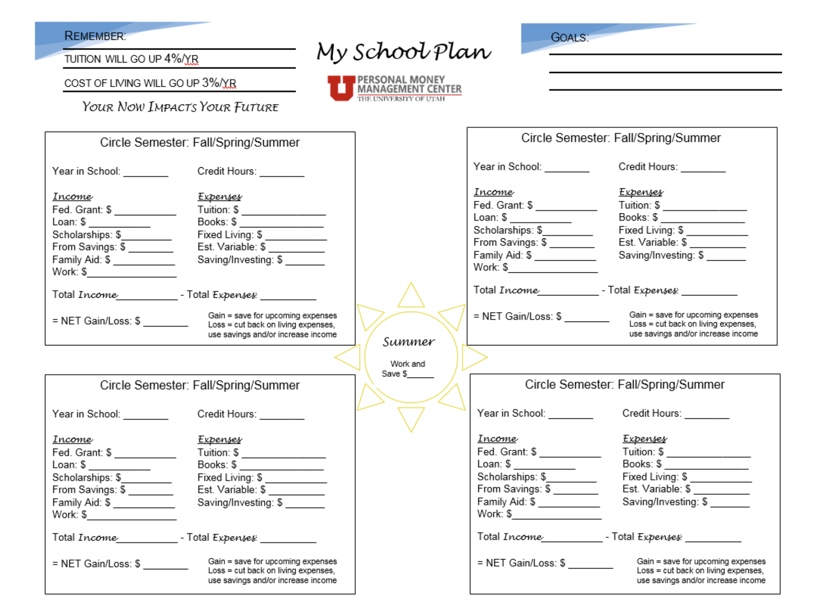

Slide 17
04
CREDIT
Understanding the importance of credit

Slide 18
What is Credit?
The ability to borrow money or access goods.
You promise to pay the total cost later or over time, along with interest.

Slide 19
BENEFITS OF ESTABLISHING GOOD CREDIT
Higher chance at getting approved for loans
Better car insurance rates
Lower interest rates on credit cards and loans
Easier approval for rental houses, apartments, and phones

Slide 20
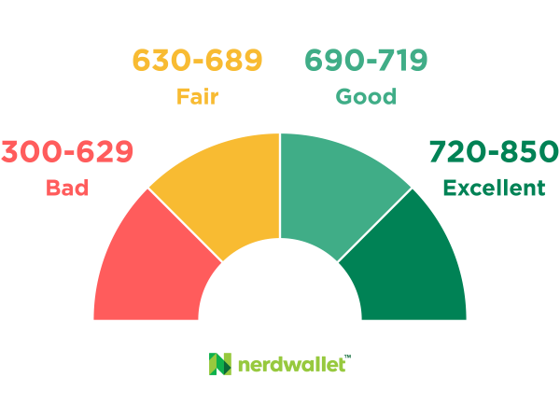
Apply for a Credit Card
HOW CAN I BUILD CREDIT?
Thaiss’ Tips for a Good Credit Score
As soon as you turn 18, go to your financial institution and apply for a starter credit card! Your credit limit (the amount of money the bank/CU is lending you) should be around $300-$500.
-Pay off your credit card balance every month
-Review your monthly statement
-Don’t use more than 50% of your credit limit
-Keep a low balance
-Compare interest rates, rewards, and fees to determine which credit card is the best

Slide 21
05
PAYING FOR
COLLEGE
How do I start?

Slide 22
3 TIPS ON SAVING FOR COLLEGE AS A HIGH SCHOOL STUDENT
Apply for Scholarships!
Get a Job and or Sell Your Stuff!
Take College Courses in High School
U of U Dream Center Scholarships
https://www.scholarships.com/
College Departments https://csbs.utah.edu/students/scholarships/
Do you have any dance attire laying around that you don’t need? Or maybe you’re an artist? Consider selling you work!
Take advantage of Concurrent Enrollment (CE) and or Advanced Placement classes (AP). Make sure to consider the pros and cons of each!

Slide 23
HOW WILL YOU START PREPARING FOR YOUR FINANCIAL FUTURE?

Slide 24
Financial Wellness Center
Budgeting
Managing student loans/scholarships
Investing
Credit
Insurance
So much more!
Follow us on social media!
Instagram: @uofu_financialwellness
Twitter: @uofu_money
Olpin Student Union Building
200 S. Central Campus Dr., Room 317
Salt Lake City, UT 84112
p: (801) 585-7379
w: Financialwellness.utah.edu
e: pmmc@sa.utah.edu
Counseling Events Resources Blog

Slide 25
CREDITS
This is where you give credit to the ones who are part of this project.
Presentation template by Slidesgo
Icons by Flaticon
Infographics by Freepik
Images created by Freepik
Author introduction slide photo created by Freepik
Text & Image slide photo created by Freepik.com

