Slide 1
Budgeting 101
10 tips for your financial wellness!
Inspired by : https://www.daveramsey.com/blog/the-truth-about-budgeting
Seth Berlin, April 2020
Notes:
Goal : simplify something that too often gets over-complicated and overlooked

Slide 2
Even though it can be stressful, don’t forget to laugh. Budgeting should be fun!

Slide 3
Before we get into it, lets answer the basics...
Q : “What is a budget?”
A : Think of it as a plan for your money
Q : “When do I use it?”
A : The typical budget is monthly
Q: “What do I need to get started?”
A: Know your income, and determine your variable and fixed expenses
Q: “Who uses a budget?”
A: Unfortunately not enough! What do you think?
Q: “How do I budget?”
A: There are many methods, but it’s important to try one out and find what works for you
A budget doesn’t limit your freedom, it gives you freedom! It’s really all about being intentional with where your money goes.
1 out of 3 Americans don’t use a budget but 93% say everyone needs one.
Source : https://www1.cbn.com/cbnnews/finance/2019/may/1-out-of-3-americans-dont-use-a-budget-but-93-say-everyone-needs-a-budget
Notes:
Q : What is a budget?
A : A plan for your money → this includes how you spend it, how much you will save, and knowing where it’s going.
Q: When do I use it?
A: although typical budgets are month by month, technically if you’re an effective budgeter-- you’re using it all the time! It’s also helpful sometimes to set up a semester budget while in school, or many people even have annual budgets. The tips we will cover apply to all time frames however. The frequency of how often you use your budget depends on you and what works best, most importantly-- you can create your budget and start using one today!
Q: Who?
A: share the statistics → emphasize that budgeting provides freedom, doesn’t take it away
Q: How?
A: You’re about to find out! There are many methods

Slide 4
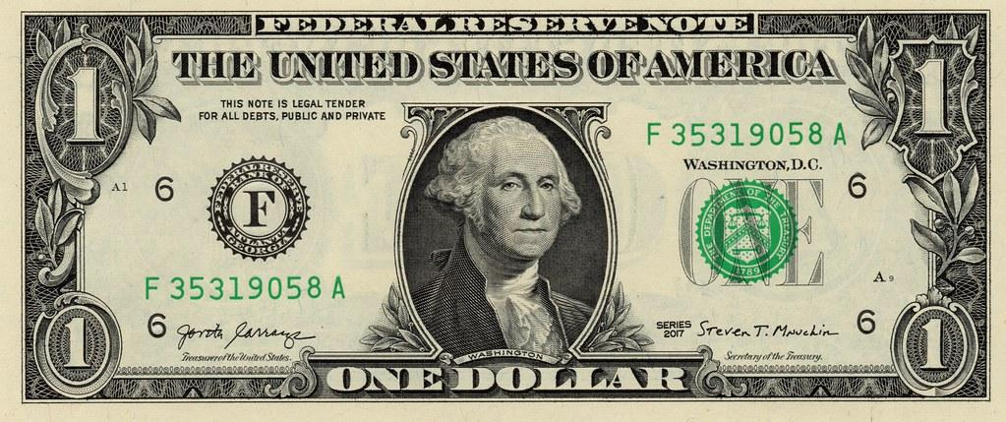
#1 : Budget to zero before the month begins
Before the months starts, you know that every dollar that comes in has a place and a purpose
All of your money is accounted for
You make $10.50 an hour and work 25 hours a week --> what does this look like for your budget? [Example]
This is #1, because every $1 counts!
Notes:
This means before the month even starts, you’re making a plan and giving every dollar a name. It’s called a zero-based budget. Now that doesn’t mean you have zero dollars in your bank account. It just means your income minus all your expenses (outgo) equals zero

Slide 5
#2 : Decide when you’ll do it, make it easy!
The basics of a budget isn’t difficult, remembering to do it is!
Maybe you’ll want to revisit your budget twice a month, think of a time that’d make it easy
It’s also helpful to schedule to some degree when your expenses will be (e.g. buying groceries on the same day of the week)
The value and benefits of your budget increase the more you use it → notice similarities, becomes routine, etc.
When you don’t have a plan, you’re going to be stressed.
Notes:
While you’re making a budget part of your monthly routine, why not pick specific dates for other expenses? Set up auto drafts out of your checking account to pay bills, and buy your groceries on a set day every week or twice a month. When you know what to expect and when to expect it, you take a lot of stress and potential pitfalls out of the picture.
(explain this idea)
How I do it : 1st Sunday and 3rd Sunday (30 mins-1 hr)

Slide 6
#3: Every month is different
When your budget doesn’t look the same every month, don’t be worried!
Plan ahead -- there are some expenses that come at the same time every year
E.g. How might December be different than August?
Christmas, back to school expenses (textbooks, travel, etc.)
Notes:
Some months you’ll have to budget for things like back-to-school supplies or routine car maintenance. Other months you’ll be saving for things like vacations, birthdays and holidays. Regardless of the occasion, make sure you prepare for those expenses in the budget. Don’t let these special occasions sneak up on you. (Hint: Christmas is in December again this year, guys!)
Be sure to adjust your budget each month as things change. Make a savings fund you can stash cash in throughout the year. When you don’t have a plan, you’re going to be stressed. And that takes all the fun out of giving and celebrating. No one wants that!

Slide 7
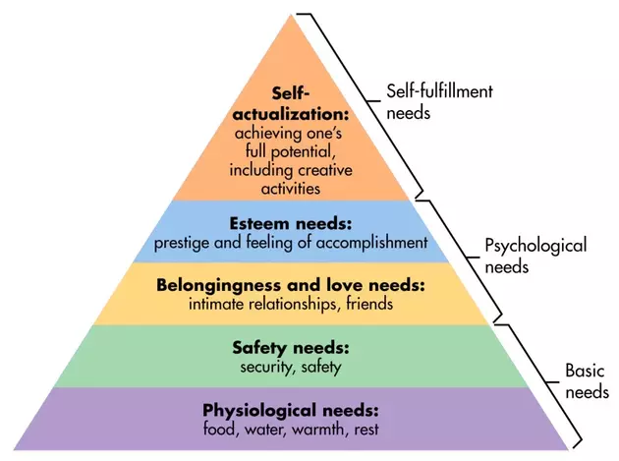
#4: Start with what’s most important
Wants vs. Needs
Ask yourself, “What do you value most?” Create your own personal budget that reflects your values
Important items such as car payments and phone bills could be set to auto-draft
Each time you visit your budget, make sure these expenses are accounted for
Notes:
Important to determine and differentiate between your Wants vs. Needs . What might be someone else’s wants could be my needs… (e.g. music, etc.) Some of these are subjective, and some are very obvious needs (shelter). However, it is important to note when reviewing your budget, and if you still need to save more money you may not be able to remove housing, but you could find a shared room or cheaper rent. Some savings take a little bit of sacrifice, but the stress relief is very well worth it.
[explain analogy of the jar, big rocks go in first… if you put the sand in the important stuff won’t fit]

Slide 8
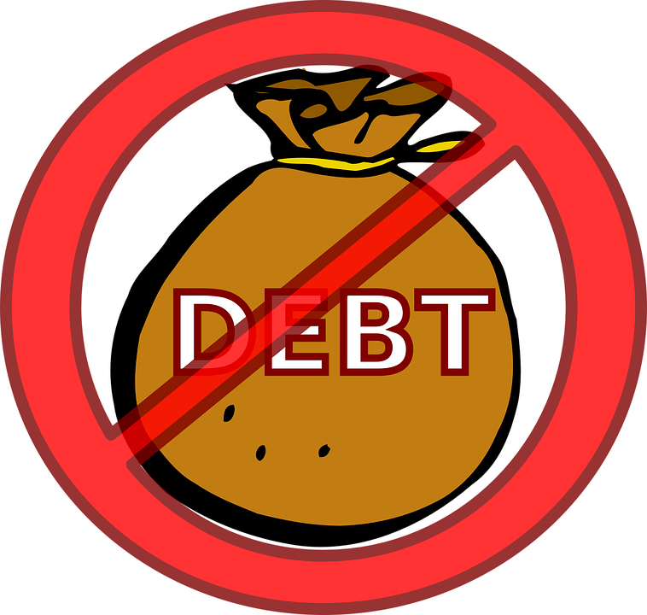
#5 Pay off any debts
If you have debt, it should be a high priority
Why? Debt isn’t very kind. It accrues or “keeps on growing”
It doesn’t care if you lost your job, had a medical emergency, or an unexpected expense
It doesn’t need to be done all at once, but you do need a plan. Think, “baby steps”
Notes:
If you have debt, paying it off needs to be a top priority. Use the debt snowball method and the Baby Steps to get rid of debt as fast as you can. Attack it! Get mad at it! Stop letting debt rob you of the very thing that helps you win with money—your income.

Slide 9
#6: Set a goal, and track your progress
What would you like to do with your extra savings? (buy one of your family members a nice gift, go on a vacation, or pay off your debts by a certain date?)
Having a goal can help keep you motivated. SMART goals are most effective
Celebrate small victories!
If you’re married, make sure you track both of your combined purchases and that your goals are aligned
Notes:
Determining what you want that will keep you motivated and to even make a few necessary sacrifices is key here. Setting a goal shouldn’t be daunting, but an exciting and motivating experience. Every step of progress should be rewarding.
SMART = Specific, Measurable, Achievable, Relevant, Time-bound
Celebrate small victories! (When you keep a record of your budgets, it’s fun to look back and see how you’ve improved over time and what changed from one month to the next. )
Just like when, this should be consistent and that you don’t neglect it once you’ve created it. I’ve done that plenty of times, so it just takes practice until it becomes a habit.
Whether you’re paying off student loans, building up your emergency fund, or paying off your mortgage, you need to focus on your why. What’s the reason you’re making these sacrifices?
It’s important to check your progress from time to time. If you’re married, track your spending and purchases together so you both keep your goals in sight. Look back at your earlier budgets to see how far you’ve come. And don’t forget to celebrate the small wins. (Pro tip: One key category to keep a close eye on is your grocery budget. I bet you are spending significantly less on groceries on a budget.)

Slide 10
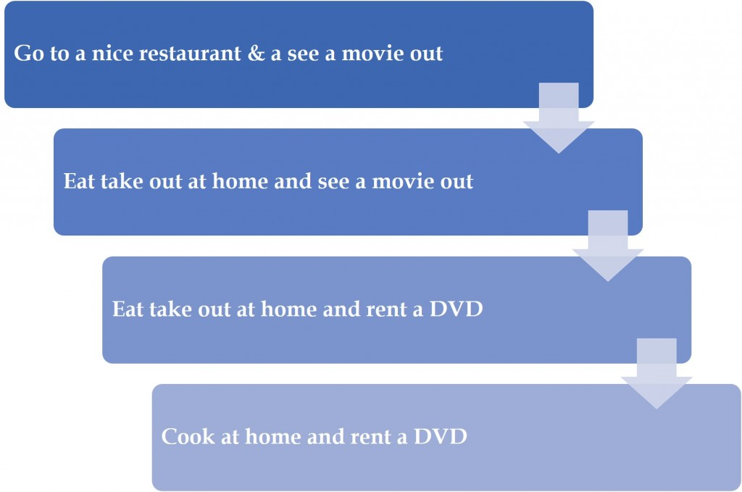
#7: Don’t be afraid to adjust the budget as needed
Step Down Method
Now that you’re tracking your budget, things start to get fun!
It might surprise you how much you spend in certain areas
You don’t always have to eliminate them from your budget
Try the “Step Down Method”
What areas do you think you can spend less in, and save more?
Notes:
Other examples and applications of the Step-down principle (.... etc.)
Brace yourself! It might be time for some budget cuts in your life. If things are tight right now, you can save money quickly by canceling your cable, dining out less, and shopping at discount clothing and grocery stores. Remember, your budget cuts are only temporary. You can always make adjustments later down the road.

Slide 11
#8: Create a buffer for yourself
Don’t let unexpected expenses catch you off-guard
Set aside a little bit of money each month for “miscellaneous” items
As things come up, (as they always do) having a buffer means you won’t have to take from areas of your budget that you’ve already planned for
If your “buffer” is repeatedly too small, consider increasing it for next month
Notes:
9. Create a buffer in your budget.
If you recognize something in this “misc.” category multiple months in a row, consider adding a permanent spot for it on the budget roster
Put a small amount of money aside for unexpected expenses throughout the month. Label this as your miscellaneous category in your budget. That way when something comes up, you can cover it without taking away money you’ve already put somewhere else. Keep track of expenses that frequently end up in this category. Eventually, you might even want to promote them to a permanent spot on the budget roster.

Slide 12
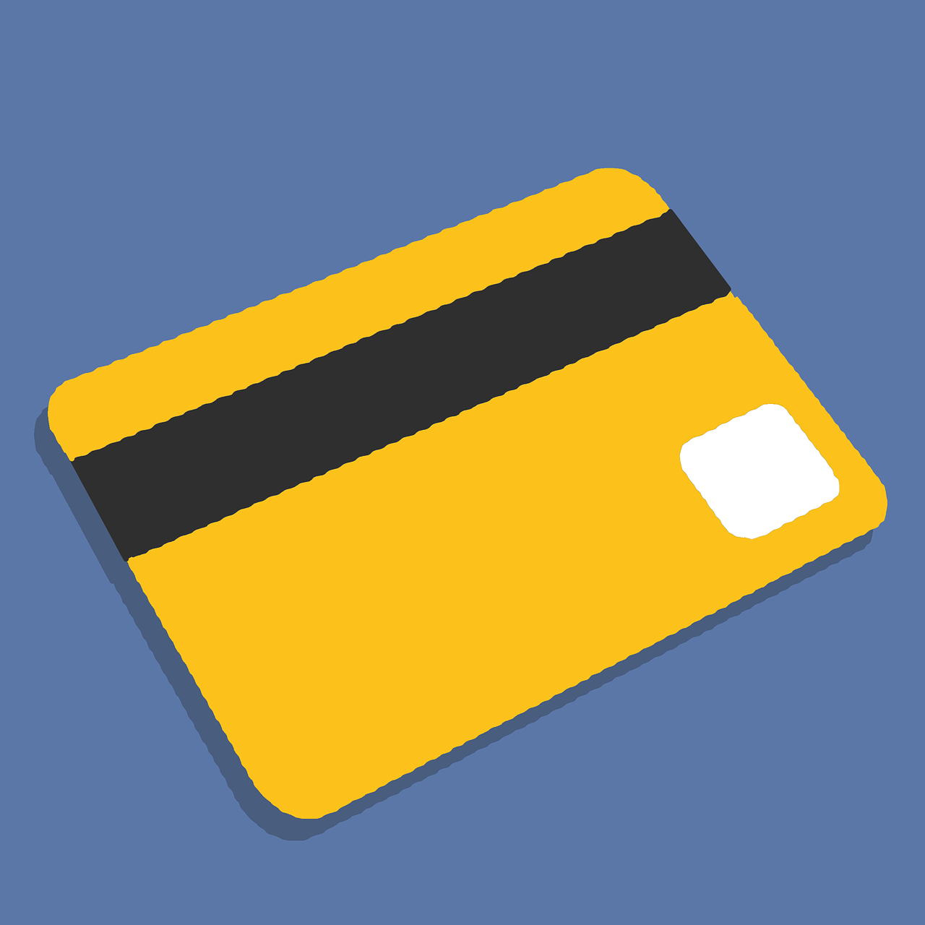
#9: Be aware of the “budget busters”
Try to avoid these expenses as best you can!
Parking tickets
Dropping a course after refund date
Overdraft charges
Late charges
Buying a meal plan and eating out instead
ID card replacement fees
Keeping up with the lifestyles of others
Notes:
A Few Keys to Point Out :
“Keeping up with the Joneses”
When you avoid comparison and rather choose to be content, you will be much happier and less stressed

Slide 13
#10: Find a method that works for you and stick to it!
Pen and Paper/Calendar :
Use a calendar to write down the due dates for specific bills
Write down pay day dates and amounts
Plan when to pay bills, and when $ will be left over for groceries and other expenses
Envelope :
Make separate envelopes for each spending category (Gas, groceries, etc.)
Use cash from that envelope to make purchases. When the cash is gone, you are done making purchases in that category
Adjust amounts as needed to manage your Spending Plan

Slide 14
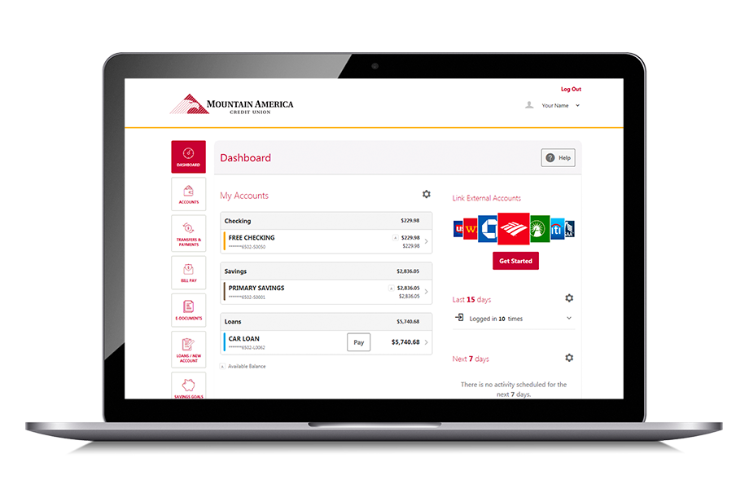
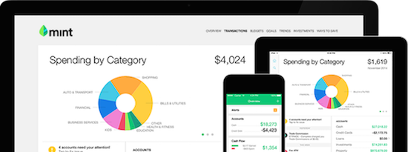
#10 cont. : If one method doesn’t work, try another :)
Using Spreadsheets (Excel) :
Easy to organize and format
Stays in one place
Requires regular updating
Electronically/Online :
Automatic updates, and all in your mobile device
Some versions are paid, but most are free
More of a passive method, but gives good detail

Slide 15
...Come visit us at the Financial Wellness Center! (virtually for now)
Want to learn more?...
Competent and confidential financial counseling services for students covering topics such as Scholarships, Paying for school, Credit, Taxes, Student loans + more)
See our website for more details (https://financialwellness.utah.edu/)
Open Monday-Friday from 8am - 5pm
Contact:
Email: pmmc@sa.utah.edu
Phone: 801-585-7359
Website: Financialwellness.utah.edu

Slide 16
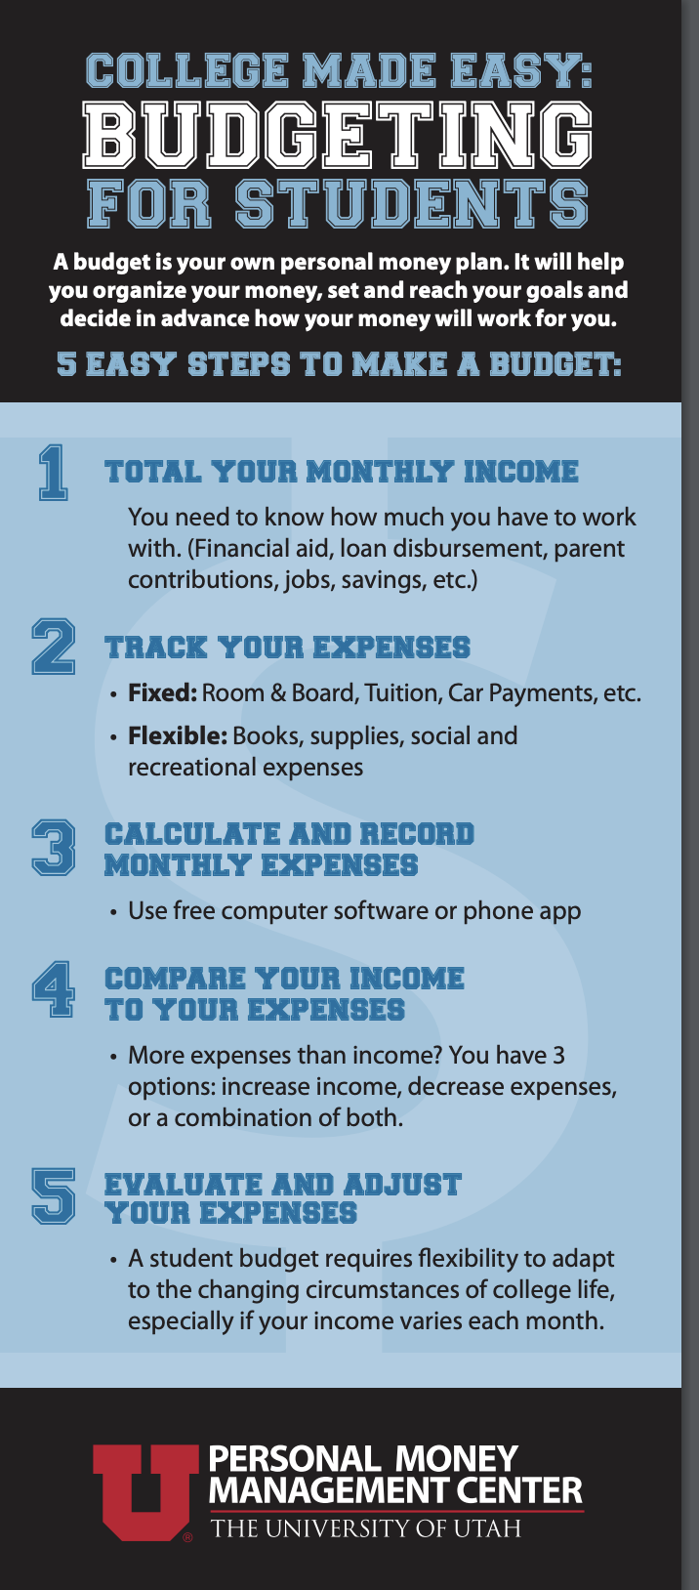
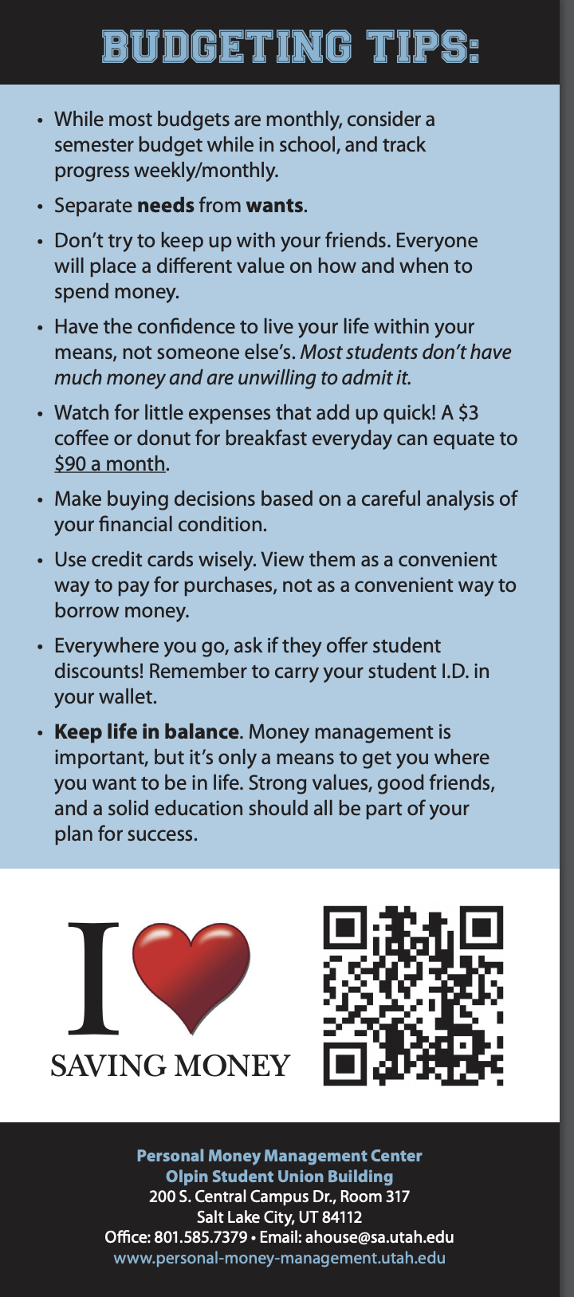

Slide 17
Electronic Options
https://www.mint.com/,https://www.savology.com/,https://moneystrands.com/,https://www.budgetsimple.com/, https://www.personalcapital.com/, and more!

Slide 18
Envelope Budget
https://youtu.be/VCr-54OH7IY

Slide 19
The Calendar Budget https://budgetbypaycheck.com/bm_video/video-three-budget-calendar/

Slide 20
Getting your grips on the “debt-snowball”
https://www.daveramsey.com/blog/get-out-of-debt-with-the-debt-snowball-plan/?int_cmpgn=no_campaign&int_dept=dr_blog_bu&int_lctn=Blog-Text_Link&int_fmt=text&int_dscpn=15_Practical_Tips_for_Your_Budget-the_debt_snowball_method

